Slide 1

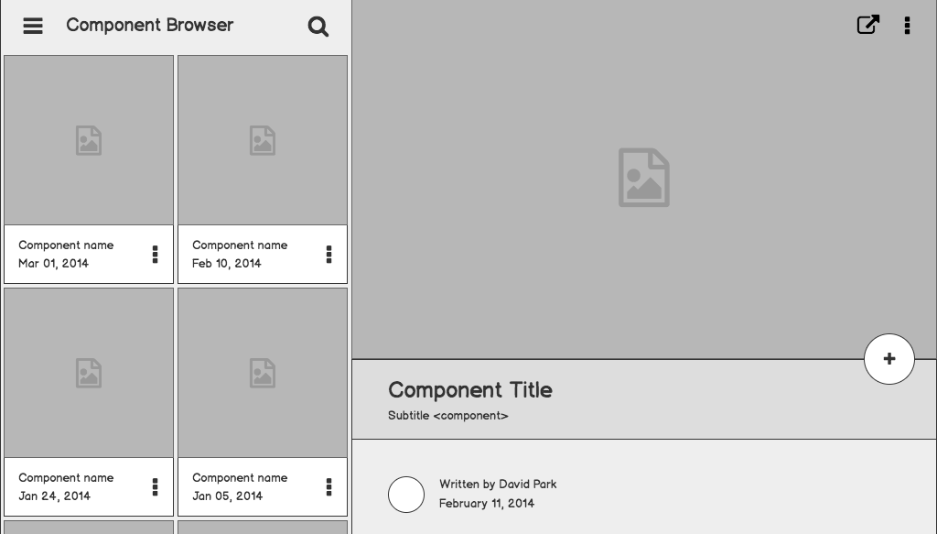
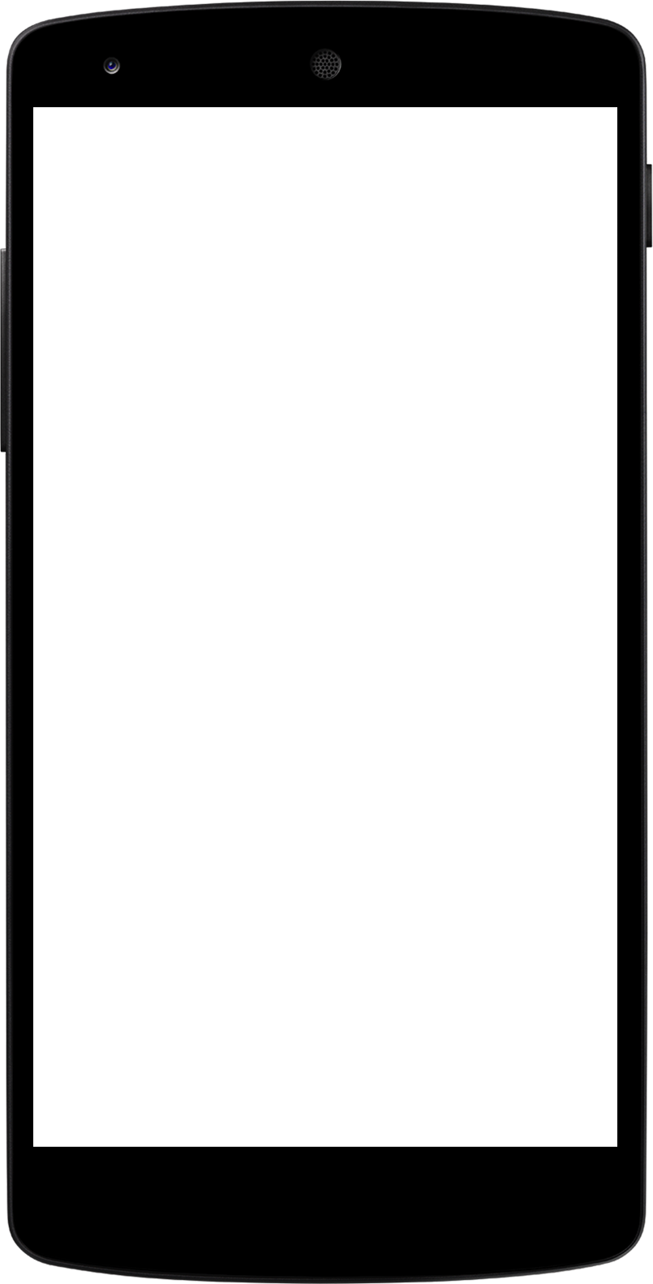
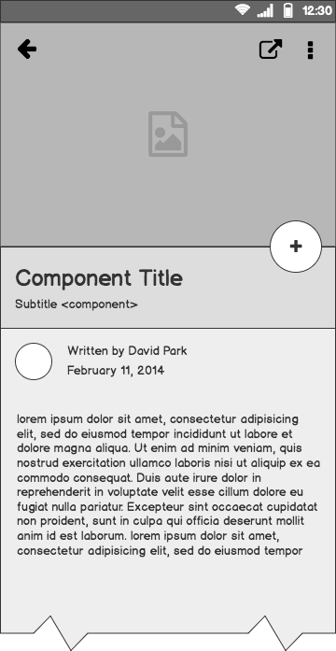
iPhone vs Android
Wirach Leelakiatiwong

Slide 2
Outline
The Problem
Data Gathering
Exploratory Data Analysis
Preprocessing and Modelling
Evaluation and Interpretation
Conclusion

Slide 3

The Problem
“Filter out iPhone related posts from online forums”
Notes:
As a data scientist at Apple, I have discussed with product development teams and found out that they are currently processing the customer feedback only from the query from Apple official websites. They feel that reports collected from forums and feedback channels are mainly about serious malfunctions containing lots of technical stuff. However, they would like to get sentiment from non-technical users for further development, i.e., 'I really love the new function in iOS 13.2.1', 'New version of Siri is fantastic!' for the following purposes ...
to see whether the users love their new function or not?
Which aspect need improvement?
What do general users expect to see in the future?
To address this problem, I decided to get non-technical comments from the reddit websites. Manual Collection seems to be a safe approach since I can directly go to ‘iPhone' subreddit and read through each single posts. Nevertheless, it is extremely labor intensive and inefficient. So in this project, I'll build a classifier to automatically distinguish iPhone posts from other kind of smartphone posts and send them to product development teams.

Slide 4
Project Overview
What type of model will be developed?
Logistic Regression
Naïve Bayes
K-Nearest Neighbors
What type of vectorizer in used?
CountVectorizer
TfidfVectorizer
How the model will be evaluated?
Accuracy (for the development phase)
ROC-AUC / FPR / TPR in production decision
Notes:
To address this problem, I suggested the team to get non-technical comments from the reddit websites. Manual Collection seems to be a safe approach since I can directly go to ‘iPhone' subreddit and read through each single posts. Nevertheless, it is extremely labor intensive and inefficient. So in this project, I'll build a classifier to automatically distinguish iPhone posts from other kind of smartphone posts and send them to product development teams.

Slide 5

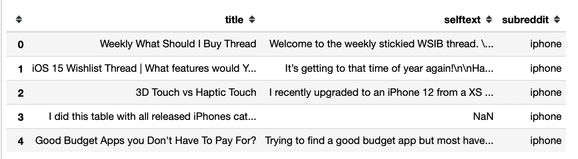
Data Gathering
r/iPhone
r/Android
876 posts
815 posts

Slide 6
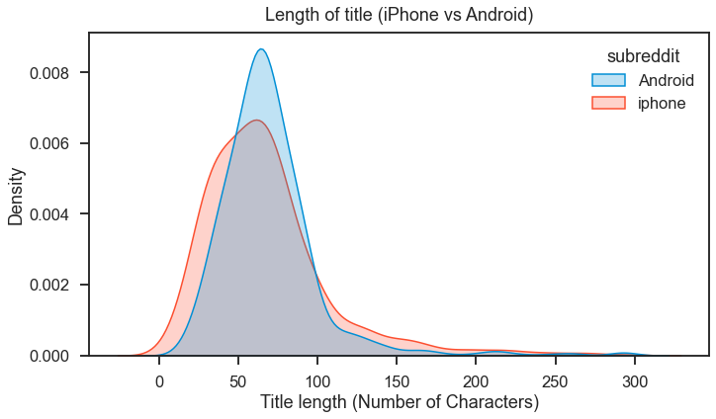
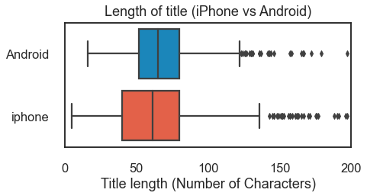
Exploratory Data Analysis
1

Slide 7
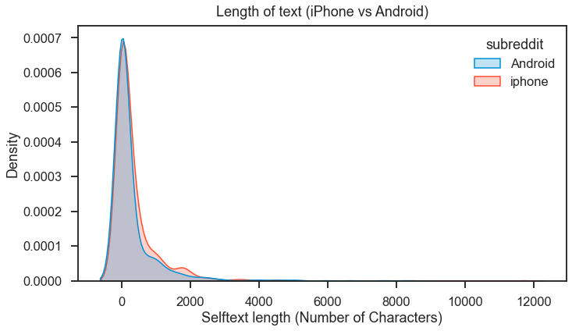
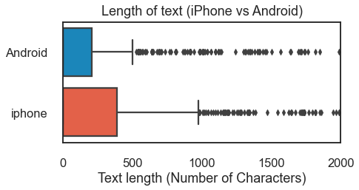
Exploratory Data Analysis
1

Slide 8
“Length of the title and text do not add much information to distinguish between iPhone and Android posts”

Slide 9
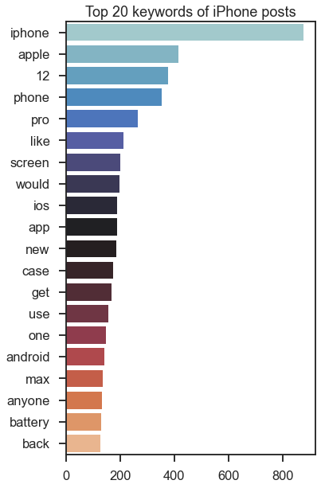
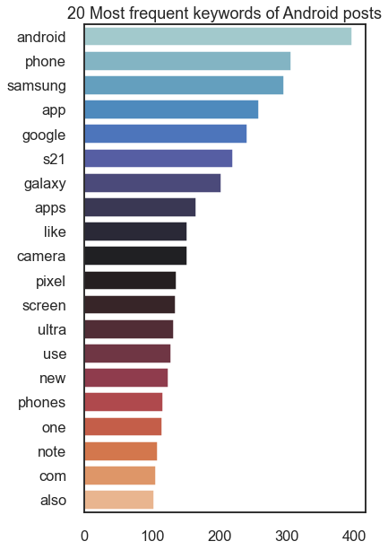
1
Notes:
Obviously, the most frequent word in iPhone corpus is 'iphone' itself, followed by apple and different iphone models such as '12', 'pro', 'max'

Slide 10
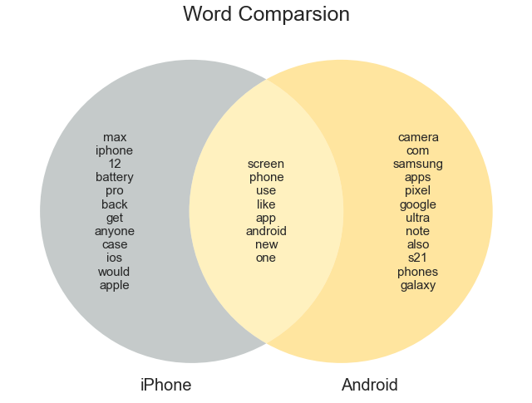
Notes:
Some of the common words that are being said in both subreddit are "android, phone, screen, app, new, one, like"
It can be inferred that people in both subreddit occasionally compared their phone with the competitors!

Slide 11
Preprocessing
Convert to lower
Remove hyperlink
Remove punctuation
Remove possible target leakage
Lemmatize
Remove stopwords
Hello, This is a Test message for in iPhone “forums”. Please visit at (https://iphone.com)
hello this is a test messag for in forum please vis at
hello, this is a test message for in iphone “forums”. please visit at (https://iphone.com)
hello this is a test message for in iphone forums please visit at (https//iphonecom)
hello this is a test message for in iphone forums please visit at
hello this is a test message for in forums please visit at
hello test messag in forum please vis
Notes:
Some of the common words that are being said in both subreddit are "android, phone, screen, app, new, one, like"
It can be inferred that people in both subreddit occasionally compared their phone with the competitors!

Slide 12
Modelling
Preliminary Performance
Accuracy | LR | NB | KNN
Count Vectorizer | 0.98 /0.84 | 0.89 /0.85 | 0.99 /0.72
Tfidf Vectorizer | 0.95 /0.86 | 0.93 /0.85 | 0.99 /0.83
Preprocessed text string
Vectorized documents
Wisdom!
Vectorizer
Note:
Baseline performance (ratio of the majority class) = 0.51
LR = LogisticRegression
NB = Multinomial NaiveBayes
KNN = Knearest Neighbors
All models are fine-tune using GridSearchCV, and the corresponding performance is its best score
Model

Slide 13
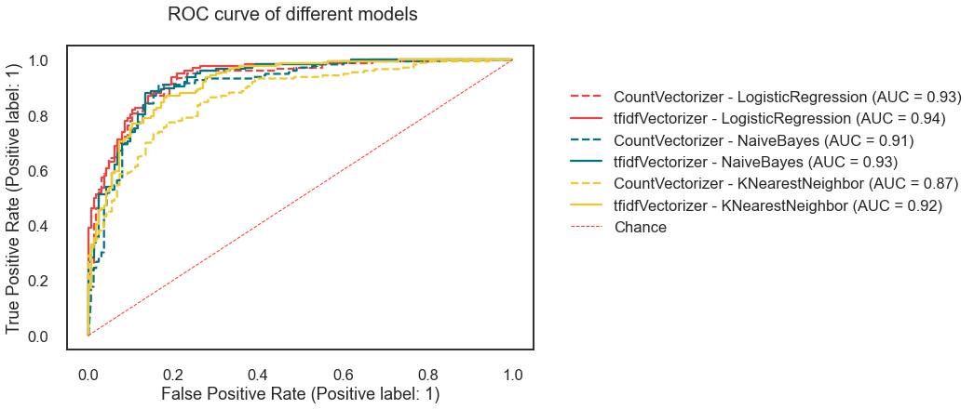
Performance Evaluation
“The performance of LogisticRegression and NaiveBayes are nearly the same while KNN is underperform”.
“Tfidf can beat CountVectorizer for every combination of the model.

Slide 14
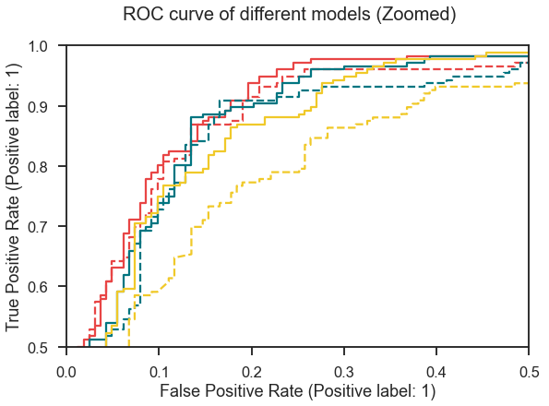
Performance Evaluation
Overall, the best model is tfidfVectorizer + LogisticRegression with the highest AUC score at 0.94 (Red-Solid Line)

Slide 15
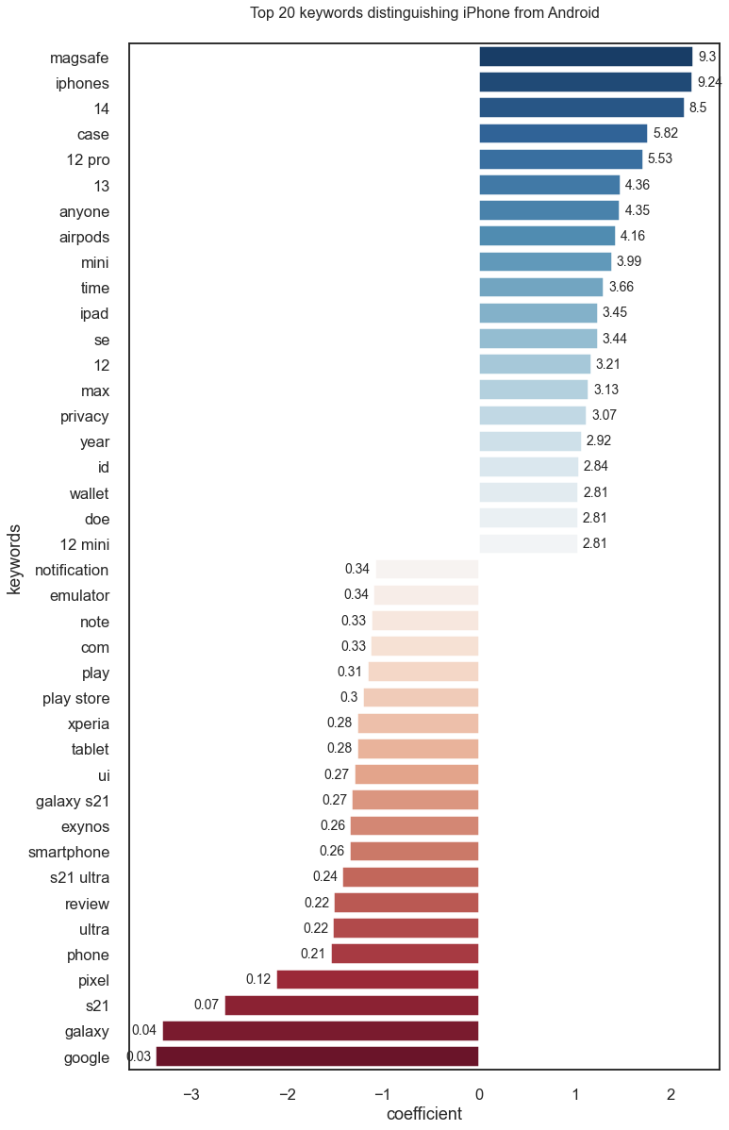
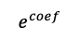
What can be infered from the model?
iPhone
Android
$$e^{coef}$$
(log coefficient)
Notes:
As discovered in the Exploratory Data Analysis (EDA) section, a post containing keywords like "12", "case", "pro", "max", "anyone" are very likely to be an iPhone post since these word are overlapped with the most frequent words.
In addition to the words listed above, some specific keywords indicating iPhone posts are "magsafe", "airpods", "mini", "id"
For android posts, the keywords indicating charateristic of android such as the model (galaxy, s21, pixel, xperia ...) are the most reliable predictors used to distinguish its from iPhone posts

Slide 16
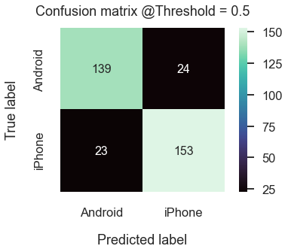
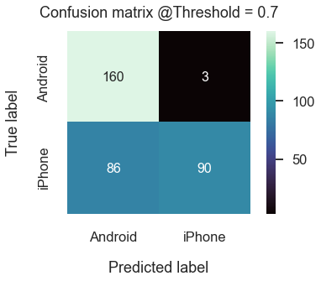
Decision Threshold @Production
By increasing decision threshold from the default value (0.5) to 0.7, we can reduce FPR to approximately 1%. However it also inevitably reduce our TPR
Notes:
The optimal threshold at 0.7 (predict a post as iPhone if the probability of being iPhone > 0.7, otherwise predict as Android) will result in half of the actual iPhone posts will be detected, while minimizing the chance of getting unintentional android post in our data.

Slide 17
Conclusion and future application
Conclusion
Best Vectorizer = TfidfVectorizer
Best Model = Logistic Regression
Optimal Decision Threshold = 0.7
Future Application
The output of the model (Cleaned dataset containing mostly iPhone related post) can be feed into a sentiment analysis algorithm to analyze the user feedback accordingly.
Improvement Ideas (From error analysis)
Take only the posts with selftext (context) into consideration
Remove ambiguous keywords and re-train the model

Slide 18
Questions?

Slide 19
Thank you!

